Slide 1
SMART DRYING RACK

Slide 2
Project presentation
combines the convenience of traditional drying racks with the advanced technology of the Internet of Things
laundry routine easier and more efficient

Slide 3
Automated control → ability to set desired drying times, the smart drying rack takes care of the rest, freeing up your time and effort
Remote monitoring → You can check the status of your drying clothes from anywhere, at any time, through the mobile app. This allows you to monitor the progress of your laundry, even when you're not at home
Community control → IOT
Provide useful information regarding the drying time of clothes

Slide 4
Functionality

Slide 6

StendApp

Slide 8
Architecture

Slide 10
Prototype

Slide 11
Immagine ThinkerCad o prototipo

Slide 12
Sensors
DHT11
Capacitive Moisture Soil Sensor
Force Sensitive Resistor
Rain Sensor ( FC-37 )

Slide 13
Attuators

Slide 14
Telegram bot

Slide 15

Flask
web application framework for building scalable, high-performance, and easy-to-deploy RESTful APIs by providing a simple and flexible framework for handling HTTP requests and responses
RESTful APIs use HTTP methods (such as GET, POST, PUT, DELETE, etc.) to perform operations on resources, where resources are identified by URIs (Uniform Resource Identifiers)

Slide 16
request parsing
URL routing
support for returning JSON and other data formats
Flask applications can be easily deployed on a variety of platforms, including cloud-based platforms like AWS
Allows you to connect to various databases to have persistent data and make queries ( CRUD operations )

Slide 17

Swagger
Tool for documenting and testing REST APIs
Provides a user-friendly interface for API documentation and testing, which can save time and effort for both developers and API users
Swagger helps enforce consistent documentation and request/response structures for your API

Slide 18
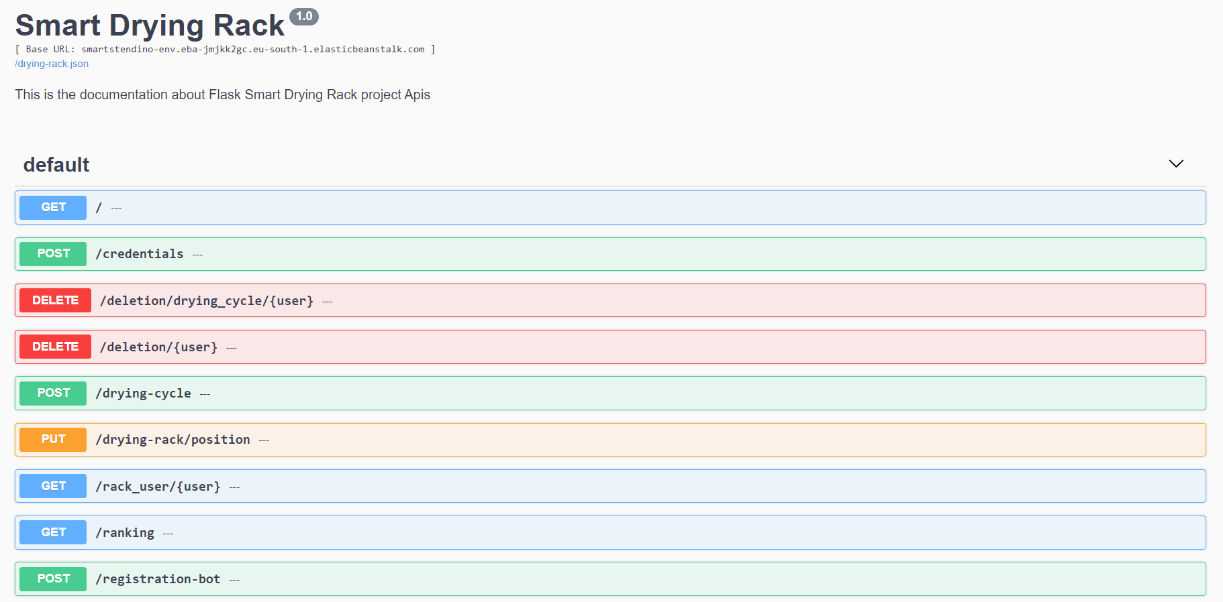

Slide 19

AWS
Elastic Beanstalk is a service for deploying and scaling web applications and services in the AWS Cloud
Support for different programming languages and diverse frameworks and web stacks
Creation of an environment that runs the application
Ideal for web application
hosting web applications without needing to maintain your own server, networking, domain

Slide 20
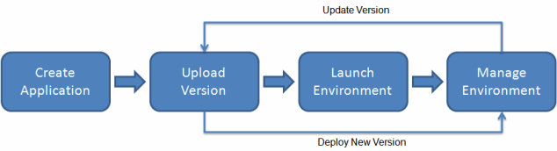
Elastic BeanStalk
manages automatically the deployment
capacity provisioning
load balancing
auto scaling
application health monitoring
log file access

Slide 21
Future evolution
AI
Integration of other AWS services
New functionalities

